Slide 1

Project Title Predicting Customer Churn for a Telecommunications Company.
Solution by: Team Alpha 1. Kushagra Gaur
2. Arpit Dubey

Slide 2
Problem Statement
A telecommunications company is experiencing high customer churn rates and wants to identify customers who are likely to leave in order to intervene before they do. They have collected a dataset of customer information, including demographics, services used, and past payment history.

Slide 3
Solution
Flow Chart
Start
Load Raw Data
Data Cleaning
Data Visualization
Splitting test & training data
Model creation & training
Prediction
Stop

Slide 4
Data Cleaning
Converting data into numeric
Dummies (one hot encode)
Back to Flow Chart

Slide 5
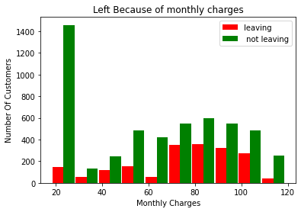
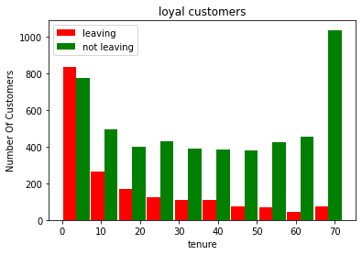
Data Visualization
Back to Flow Chart

Slide 6
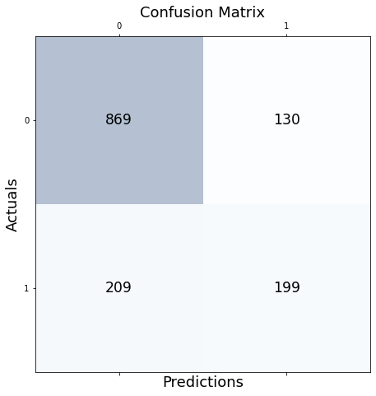
Prediction
Back to Flow Chart

Slide 7
Technologies Used
Tensor Flow
Keras
MatplotLib
Sk Learn
Jupyter Notebook
Nvidia GEFORCE GPU
VS Code

Slide 8
Output

Slide 9
Thank You
Enjoyed the Acehack 2.0

